Slide 1
Mobile Application Development - Day 7
DATABASE

Slide 2
Database
SQLite
  SQLite is a C-language library
  It implements a small, fast, self-contained, high-reliability, full-featured, SQL database engine
  Lite in SQLite means light weight in terms of setup, database administration and required resource.

Slide 3
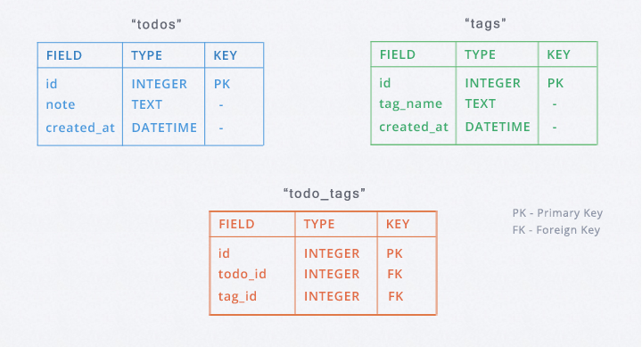
Database Tables

Slide 4
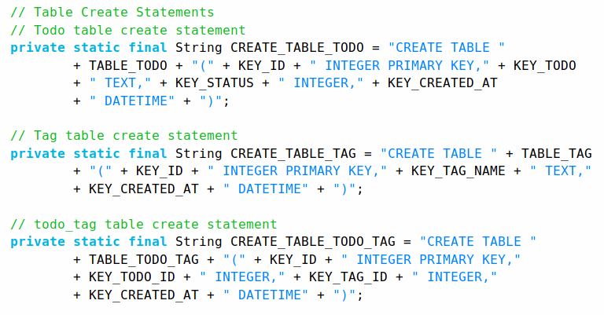
Sqlite Queries For creating table

Slide 5
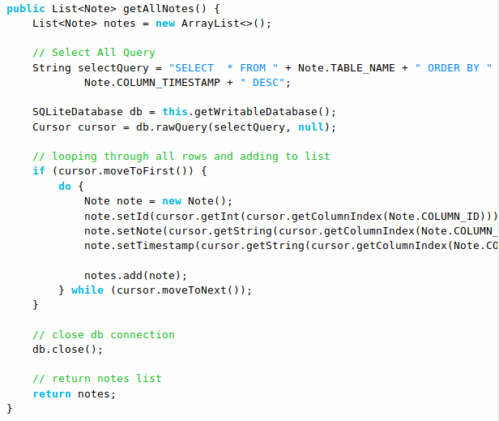
SQLite Queries

Slide 6
Room
Room is a new way to create a database in android applications.
Room is a database layer on top of SQLite database
Room uses DAO(Data Access Object) to issue queries to its database
  DAO is an abstract class or interface that includes methods to define database queries.
Room is much similar to ORMLite.

Slide 7
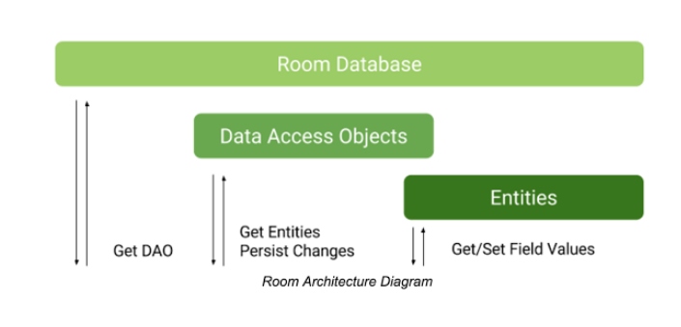
Roo Architecture Diagram

Slide 8
DAO
@Query("SELECT * FROM Book " +
"INNER JOIN Loan ON Loan.book_id == Book.id " +
"WHERE Loan.user_id == :userId "
)
public List<Book> findBooksBorrowedByUser(String userId);

Slide 9
DAO
@Query(“select * from Students”)
List<Students> getAllStudents()
@Query(“select * from Students where name=’student_name’”)
List<Students> getAllStudents(String student_name)

Slide 10
Entities
@Entity(tableName = "user")
public class User {
@PrimaryKey(autoGenerate = true)
private int uid;
@ColumnInfo(name = "first_name")
private String firstName;
//generate getter and setters

Slide 11
ORM (Object Relational Mapping)
framework used to map an object to a relational database
ORM is technique for storing, retrieving, updating and deleting from an object oriented program in a relational database.

Slide 12
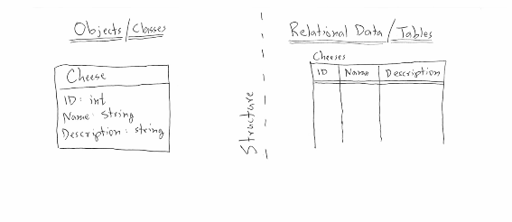
ORM

Slide 13
Major Component
Database
Entity
DAO

